Slide 1

CompareKaro- A smarter way to shop
School of Computer Science and Engineering
Department of Computer Science and Engineering
Submitted By: Nainitha Yalamaddi
2427030125
Supervised By: Dr. Ashish Kumar

Slide 2
Outline
Introduction
Literature Review
Problem Statement
Objectives
Proposed Methodology
Testing and Future Deployment
Results
Outcome
References

Slide 3
Introduction
Today's online shopper face a new dilemma: an overwhelming abundance of choice that often leads to decision failure.
Customers are forced to juggle dozens of browser tabs, cross-reference prices on Amazon, Flipkart, and other sites, and decipher conflicting reviews, all while trying to factor in delivery costs and overall value. It's a time-consuming and often unreliable process.
That's where Comparekaro comes in, the intelligent shopping platform that does the heavy lifting for you. Making online comparison shopping by moving beyond simple price checks to deliver an overall, ranked buying guide tailored to every need.

Slide 4
Comprehensive, All-in-One Scans: Just search for a product and the engine will search all major e-commerce sites in real time. Shows you the entire market in a single, easy-to-read results page.
Smart Ranking: It does not just simply list choices, it ranks them. The smart ranking takes into account all of the relevant factors so you don’t have to:
Best Value (Overall Rank): The smartest buy, balancing cost and quality.
Lowest Total Price: Includes the product cost and delivery charges.
Top Rated: Prioritizes products with consistently positive and authentic reviews.
Most Popular: Highlights items that are frequently bought.
Intelligent Cart Comparison: Add similar products (e.g., two different Bluetooth headphones) to comparison cart, and it will directly compare their features, prices, and reviews side-by-side. This eliminates guessing and helps pinpoint the exact product that matches customer preference, not just budget.

Slide 5
Literature Review
Studied platforms like CompareRaja and PriceDekho.
Observed that most platforms focus only on electronics.
Identified lack of structured product ranking mechanisms.
Found that users must manually compare specifications.
Noted limited support for non-technical users.

Slide 6
Research Gap Identification
No unified platform providing simplified comparison and ranking.
Existing systems require prior technical knowledge.
Lack of clear decision-support structure.
Limited customization based on user needs.
Need for an intuitive and user-friendly comparison system.

Slide 7
Problem Statement
Users face difficulty in comparing products across multiple e-commerce platforms due to the lack of a structured ranking and simplified comparison system.

Slide 8
Objectives
To develop a user-friendly web interface for comparing products across multiple e-commerce platforms.
To provide a structured comparison system based on price and key features.
To reduce user decision-making time through organized product ranking.
To design a scalable system ready for backend integration and real-time price updates.

Slide 9
Proposed Methodology
Requirement Analysis
Studied existing product comparison platforms and identified limitations.
Analyzed user problems in comparing products across multiple websites.
Defined functional requirements (comparison, ranking, navigation).
Identified need for a simple and structured interface.
Planned scalable architecture for future backend integration.

Slide 10
System Design
Designed overall system architecture (Frontend → Backend → Database).
Created wireframes for Home, Login,Create Account, Comparison, and Contact pages.
Planned product display using structured cards layout.
Defined ranking parameters (price, features, availability).
Ensured responsive and user-friendly design principles.

Slide 11
Implementation
Developed frontend using HTML ,CSS and JavaScript.
Created responsive UI for better user experience.
Implemented Login and Signup system.
Integrated frontend with backend server.
Enabled dynamic data handling.

Slide 12
Backend & Database
Developed backend for authentication system
Implemented user login verification
Stored user credentials in database
Ensured persistent data storage
Technologies used:
Backend: PHP
Database: MySQL

Slide 13
Testing & Future Deployment
Tested UI responsiveness and navigation
Verified login and authentication system
Checked database storage and retrieval
Handled invalid login cases
Ensured smooth frontend-backend integration

Slide 14
Result
Functional frontend successfully developed
Login system implemented successfully
User data stored and retrieved from database
Backend successfully integrated with frontend
System supports real user interaction

Slide 15
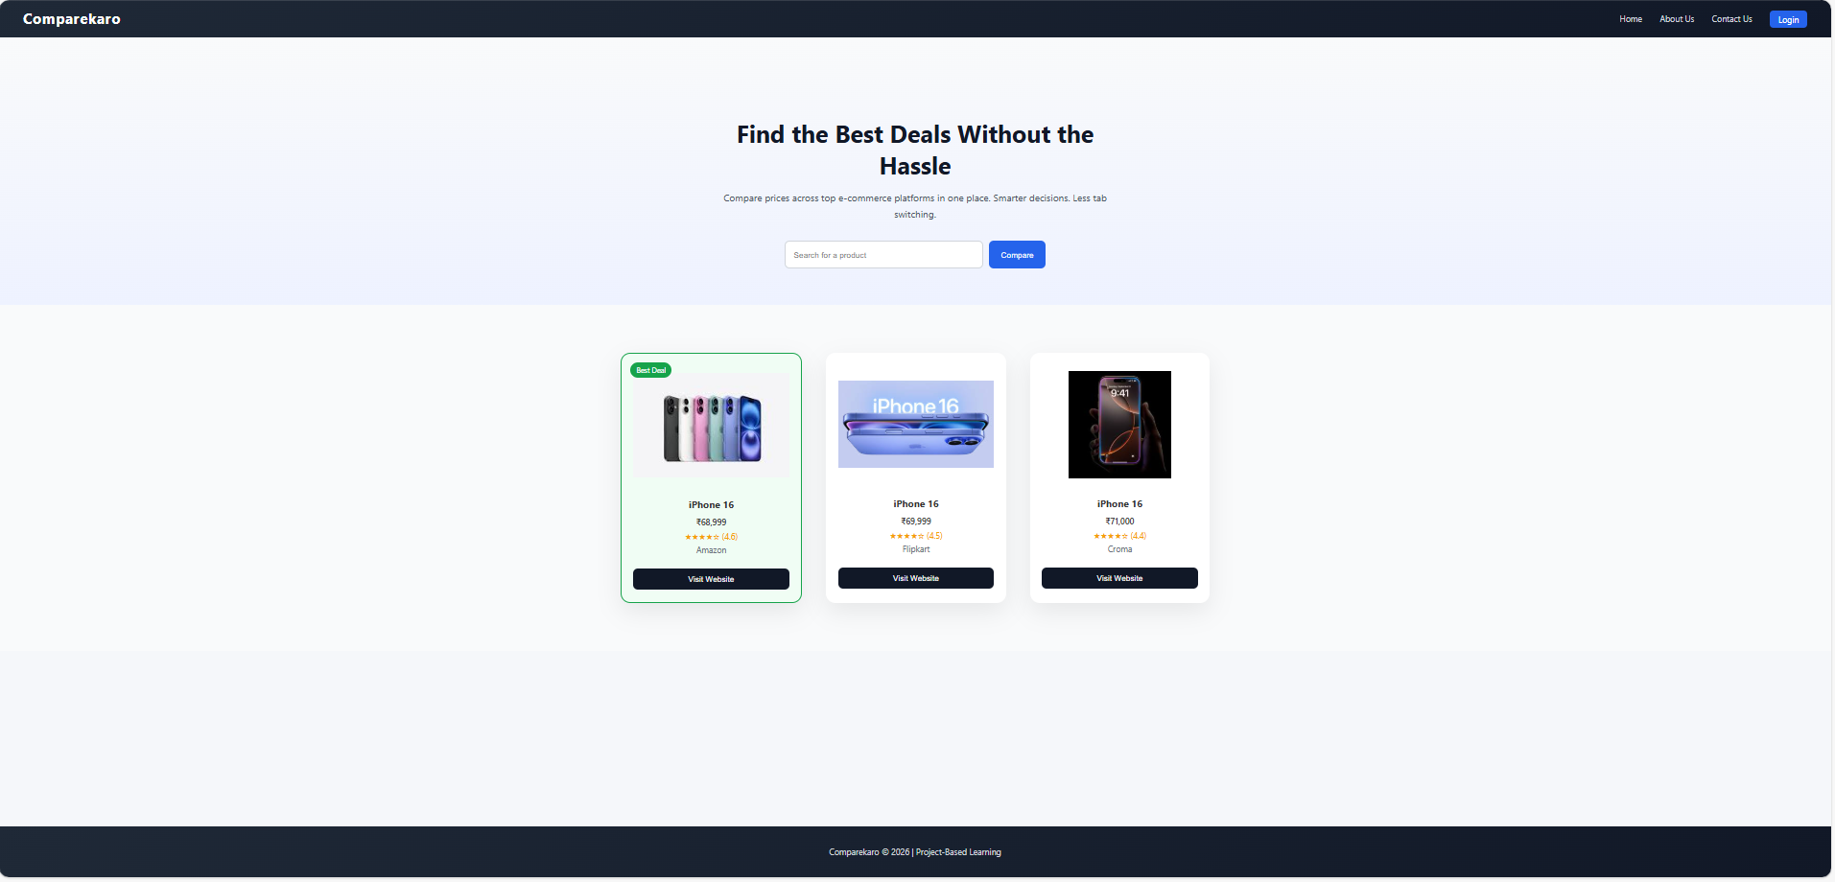
Home Page

Slide 16
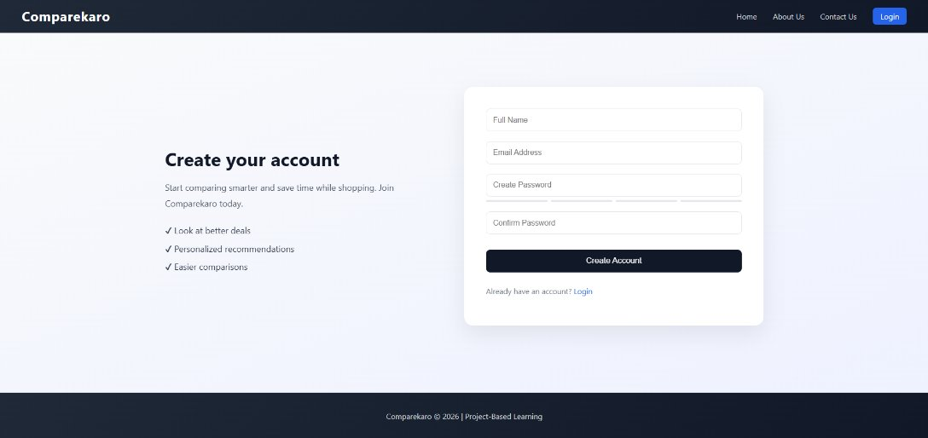
Create One

Slide 17
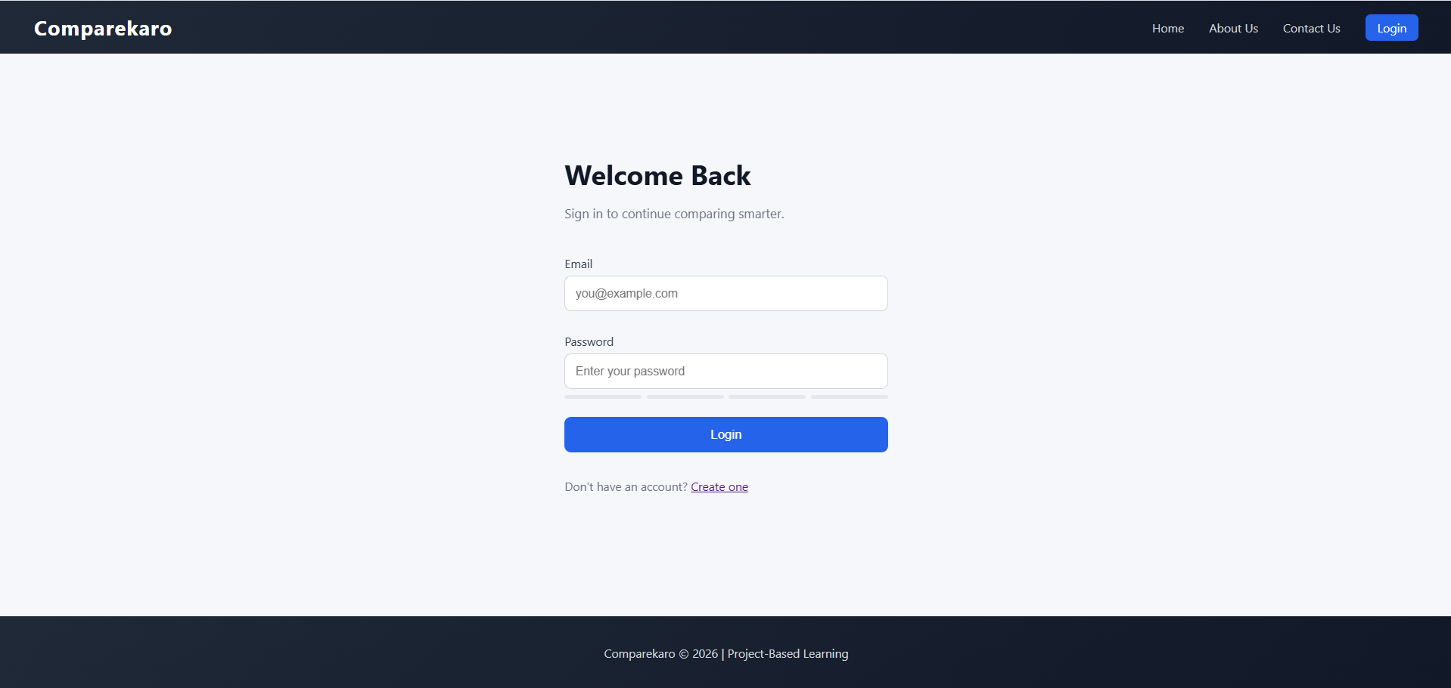
Login

Slide 18
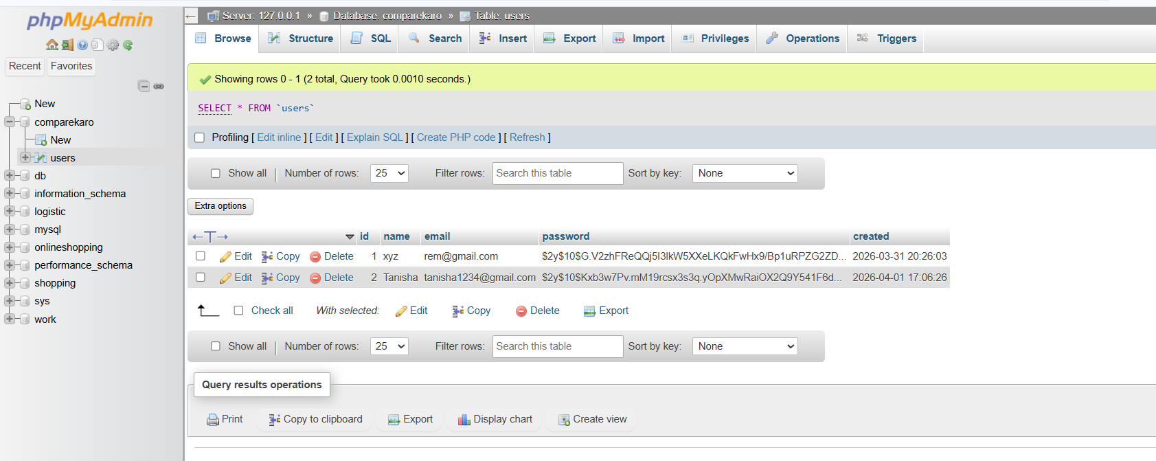
Database Table

Slide 19
Outcome
Achievement
Built a partially functional full-stack application
Successfully implemented authentication system
Database integration completed
System ready for further feature expansion

Slide 20
References
CompareRaja Official Website. Available at: https://www.compareraja.in
PriceDekho Official Website. Available at: https://www.pricedekho.com
Google Shopping. Available at: https://shopping.google.com
Nielsen Norman Group. (2020). Principles of User Interface Design.

Slide 21
Thank You

